Slide 1
Smart Automated Parking System
Group 3 Members
1. Nkum Collins Osei - 1873222
2. Owusu Michael Boamah - 1873722
3. Abdulai Sadique - 1870922
4. Wesley Akanyako - 1871222
5. Isaac Boateng - 7148621

Slide 2
Table of Contents
1. Problem Statement
2. Methodology
3. Code & Schematics Overview
4. Demonstration & Simulation
5. Findings & Challenges
6. Conclusion & Future Improvements

Slide 3
Problem Statement
Manual parking systems are inefficient.
Drivers struggle to find parking spots, causing congestion.
No automated system to check if parking is full before entering.
Our solution provides
Real-time automated parking detection
Gate control based on parking availability
Improved parking management and efficiency.

Slide 4
Methodology
Ultrasonic sensors detect available parking spots.
LEDs indicate parking availability (Red = Occupied, Green = Free).
Gate opens only if parking space is available.
LCD displays real-time parking status.
Buzzer sounds when parking is full, and a car is detected.

Slide 5
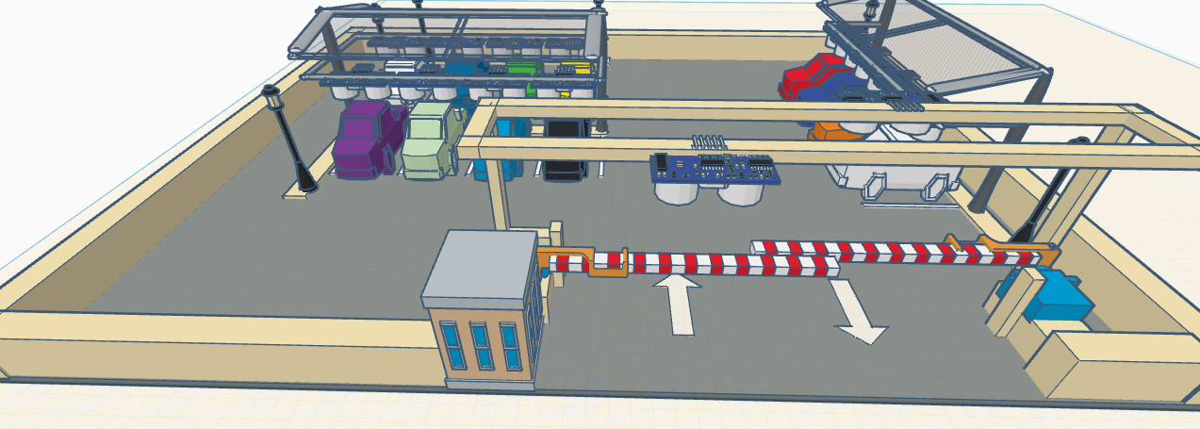
3D Representation of our project Link to 3D of our project

Slide 6
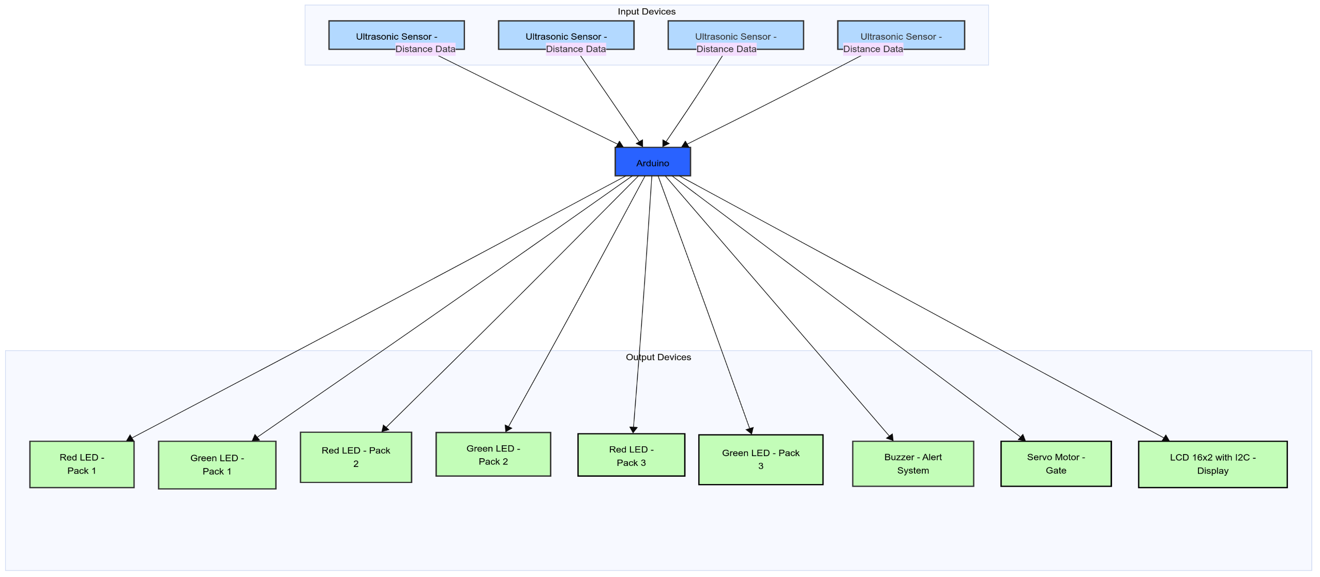
Block Diagram

Slide 7
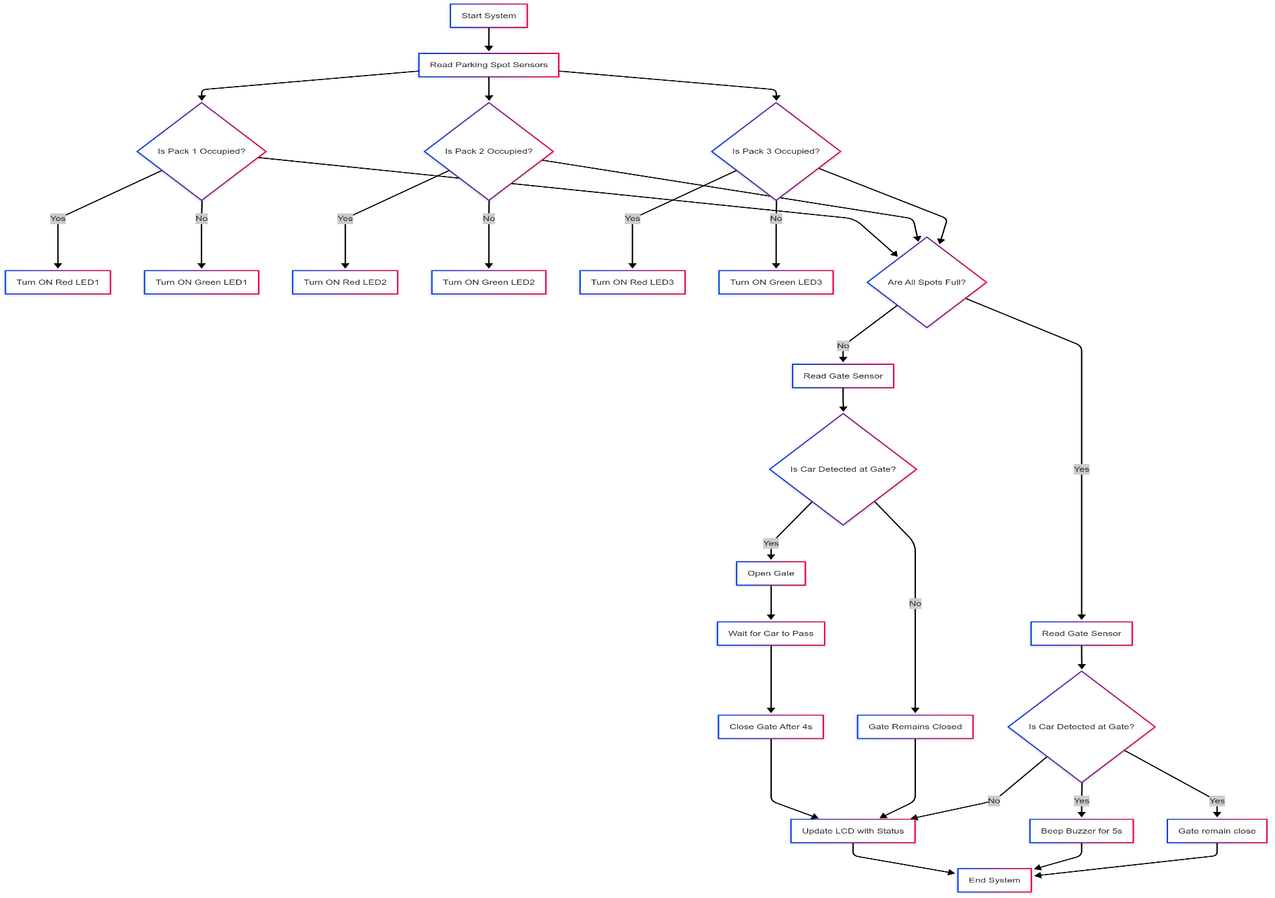
Flowchart

Slide 8
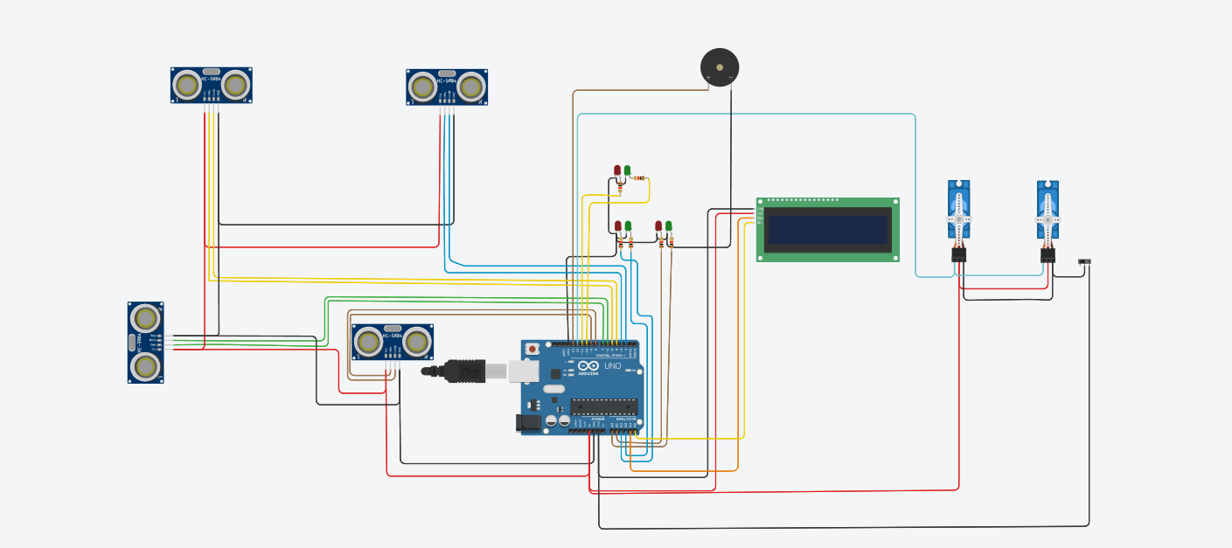
Circuit Diagram

Slide 9
Demonstration & Simulation
Live simulation of the system.
Observations:
Parking spots are correctly detected.
Gate opens/closes based on parking status.
Buzzer activates only when full parking is detected.
link to Project Demonstration

Slide 10
Conclusion & Future Improvements
Findings
Successfully implemented an automated parking system.
Efficient, user-friendly, and scalable.
System works as expected, reducing manual effort.
Challenges
Sensor calibration issues.
Power supply management.
Servo motor responsiveness.
Future Improvements
Mobile App Integration for remote monitoring.
AI-based prediction for parking availability.
RFID-based entry system for registered vehicles.

Slide 11
THANK YOU

